Slide 1

Current Design Status
Quoc Le

Slide 2
Project Idea
Designed interactive system that display approximated satellite position

Slide 3
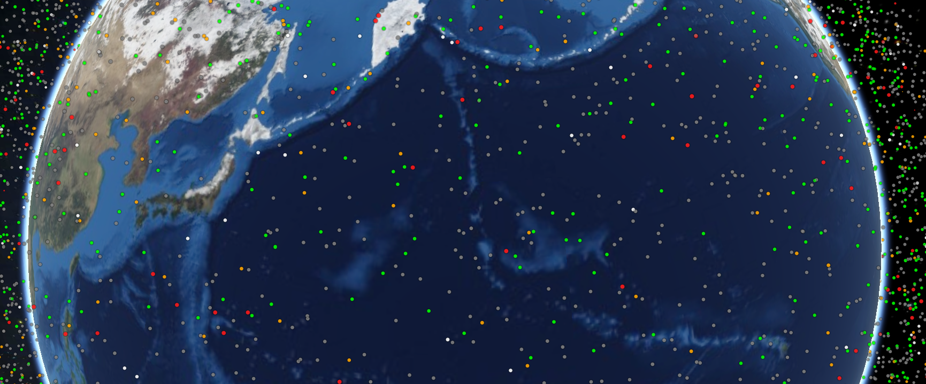
Scaling
1 Unity Meter = 158.925 KM
Satellite scale for visuality is 0.1 Unity Meter and to match CelesTrak visualization

Slide 4
Data
Data from Celestrak
Data Given in NORAD Two-Line Element Set Format
Divided the data into categories
For satellite with multiple categories, will match by given name

Slide 5
Categories Markers
Satellite’s Categories e.g., Communications Satellites, as color
If an Active satellites can illuminations if active
Other categories to be determine

Slide 6
Satellite Orbit
Modify C# NORAD SGP4/SDP4 Implementation by Michael F. Henry to work with Unity

